Slide 1

IMDB Movie Analysis
By – Md Javed Momin

Slide 2
Table of Contents
Project Description
Approach
Tech Stack Used
Insights : Movie Genre Analysis
Insights : Movie Duration Analysis
Insights : Language Analysis
Insights : Director Analysis
Insights : Budget and Gross Earnings Analysis
Project Achievements
Project Links
Conclusion

Slide 3
Project Description
The project aimed to analyze and gain insights into the movie industry, focusing on factors like movie genres, duration, language, directors, and the financial performance of movies.
The primary objectives were to understand the impact of these factors on movie ratings, financial success, and identify key contributors to movie success.

Slide 4

Project Description
1
2
3
4
5
Movie Genre Analysis: We started by analyzing movie genres. We counted the number of movies in each genre and calculated descriptive statistics for IMDb scores. This allowed us to understand which genres are more likely to receive higher ratings.
Movie Duration Analysis: We examined the distribution of movie durations and their impact on IMDb scores. Descriptive statistics and scatter plots were used to visualize the relationship between duration and ratings.
Language Analysis: We determined the most common languages in movies and analyzed their influence on IMDb ratings. This involved counting movies by language and calculating statistics to compare their impact.
Director Analysis: To explore the influence of directors, we calculated the average IMDb score for each director. We also used percentile calculations to identify the top directors based on their IMDb scores.
Budget and Gross Earnings Analysis: We analyzed the correlation between movie budgets and gross earnings to understand the financial performance of movies. Additionally, we identified movies with the highest profit margins.

Slide 5


Approach - Data Cleaning and Preparation
Dataset was provided by Trainity. The Dataset consists of 5,043 Rows & 28 Columns.
Data cleaning is a crucial step to ensure the accuracy and consistency of the dataset. We removed duplicates and formatted data properly. This step was critical to avoid any issues in subsequent analyses.

Slide 6

Tech-Stack Used
Microsoft Excel 365: Microsoft Excel 365 was the primary software used for data analysis, cleaning, and visualization. It provided essential functions for data manipulation, descriptive statistics, and creating charts. It was instrumental in performing various data analyses in this project.
Microsoft PowerPoint 365: Microsoft PowerPoint 365 was used to create presentations summarizing the project's findings and insights. It allowed for the creation of visually engaging slides to communicate the results effectively.

Slide 7

Insights - Movie Genre Impact on IMDB Ratings
We analyzed the distribution of movie genres and their impact on IMDB scores.
Key findings include the observation that Film-Noir genre has the highest average IMDB rating, while Game-Show has the lowest.
We discovered the influence of genre on movie ratings.

Slide 8

Insights - Movie Genre Impact on IMDB Ratings
Counting Genres: We used the COUNTIF function in Excel to count the number of movies in each genre. Multiple genres for a single movie were separated to ensure accurate counts.
Calculating Descriptive Statistics: We used Excel functions like AVERAGE, MEDIAN, MODE, MAX, MIN, VAR, and STDEV to calculate descriptive statistics for IMDb ratings for each genre. These statistics allowed us to understand the impact of genre on movie ratings.

Slide 9
Genres | Count of Genre | Mean (Average) (IMDB Rating) | Median (IMDB Rating) | Mode (IMDB Rating) | Max (IMDB Rating) | Min (IMDB Rating) | Variance (IMDB Rating) | Std. Deviation (IMDB Rating)
Action | 1143 | 6.24 | 6.3 | 6.1 | 9.1 | 1.7 | 1.24 | 1.11
Adventure | 913 | 6.44 | 6.6 | 6.7 | 8.9 | 1.9 | 1.27 | 1.13
Animation | 242 | 6.58 | 6.7 | 6.7 | 8.6 | 1.7 | 1.29 | 1.14
Biography | 292 | 7.15 | 7.2 | 7 | 8.9 | 4.5 | 0.52 | 0.72
Comedy | 1862 | 6.19 | 6.3 | 6.7 | 9.5 | 1.7 | 1.19 | 1.09
Crime | 883 | 6.56 | 6.6 | 6.6 | 9.3 | 2.4 | 1.05 | 1.02
Documentary | 120 | 7.18 | 7.4 | 7.5 | 8.7 | 1.6 | 1.11 | 1.05
Drama | 2571 | 6.76 | 6.9 | 7.2 | 9.3 | 2 | 0.91 | 0.95
Family | 543 | 6.25 | 6.4 | 6.7 | 8.7 | 1.7 | 1.44 | 1.2
Fantasy | 601 | 6.31 | 6.4 | 6.7 | 8.9 | 1.7 | 1.34 | 1.16
Film-Noir | 6 | 7.63 | 7.65 | Mode Doesn't Exist | 8.2 | 7.1 | 0.16 | 0.39
Game-Show | 1 | 2.9 | 2.9 | Mode Doesn't Exist | 2.9 | 2.9 | 0 | 0
History | 205 | 7.08 | 7.2 | 7.5 | 8.9 | 2 | 0.78 | 0.89
Horror | 556 | 5.83 | 5.9 | 6.2 | 8.7 | 2.2 | 1.26 | 1.12
Music | 323 | 6.46 | 6.7 | 7.1 | 8.5 | 1.6 | 1.44 | 1.2
Musical | 131 | 6.51 | 6.7 | 7 | 8.5 | 2.1 | 1.49 | 1.22
Mystery | 492 | 6.49 | 6.6 | 6.6 | 8.6 | 2.2 | 1.17 | 1.08
News | 3 | 7.53 | 7.4 | Mode Doesn't Exist | 8.1 | 7.1 | 0.18 | 0.42
Reality-TV | 2 | 4.75 | 4.75 | Mode Doesn't Exist | 6.6 | 2.9 | 3.42 | 1.85
Romance | 1096 | 6.45 | 6.5 | 6.5 | 8.6 | 2.1 | 0.99 | 1
Sci-Fi | 603 | 6.28 | 6.4 | 6.7 | 8.8 | 1.9 | 1.46 | 1.21
Short | 5 | 6.38 | 6.5 | Mode Doesn't Exist | 7.1 | 5.2 | 0.45 | 0.67
Sport | 181 | 6.6 | 6.8 | 7.2 | 8.7 | 2 | 1.21 | 1.1
Thriller | 1394 | 6.31 | 6.4 | 6.1 | 9 | 2.2 | 1.11 | 1.05
War | 211 | 7.07 | 7.1 | 7.1 | 8.6 | 2.7 | 0.76 | 0.87
Western | 93 | 6.7 | 6.8 | 6.5 | 8.9 | 3.8 | 1.1 | 1.05

Slide 10

Insights - Movie Duration and IMDB Scores
Calculating Descriptive Statistics: Descriptive statistics like mean, median, and standard deviation were calculated for movie durations.
Scatter Plot: To visualize the relationship between movie duration and IMDb score, we created a scatter plot and added a trendline.

Slide 11

Insights - Movie Duration and IMDB Scores
In the analysis of movie duration and its impact on IMDB scores, we found a positive relationship between Longer movies and Higher IMDB scores.
The data revealed that, on average, movies with longer durations tend to receive higher ratings.

Slide 12
Average Movie Duration (Mins) | 107.2133253
Median (Mins) | 103
Std. Deviation (Mins) | 25.24624159

Slide 14
Insights - Language Influence on IMDB Ratings
The analysis of movies based on language showed varying mean IMDB scores across different languages.
English had the most significant representation, and its mean IMDB score was slightly below the overall average.
However, some languages like Arabic and Danish had higher average IMDB ratings, indicating language might influence viewer ratings.

Slide 15
Insights - Language Influence on IMDB Ratings
Counting Languages: We employed the COUNTIF function to count movies by language.
Calculating Descriptive Statistics: Mean, median, and standard deviation were calculated for IMDb scores by language. This helped in understanding the influence of language on movie ratings.

Slide 16
Insights – Top 10 Languages
Language | Movies Count | Mean (Average) (IMDB Ratings) | Median (IMDB Ratings) | Std. Deviation (IMDB Ratings)
Cantonese | 11 | 6.95 | 7.2 | 0.67
English | 4662 | 6.4 | 6.5 | 1.12
French | 73 | 7.04 | 7.2 | 0.72
German | 19 | 7.34 | 7.6 | 0.93
Hindi | 28 | 6.63 | 6.95 | 1.37
Italian | 11 | 7.23 | 7.3 | 1.19
Japanese | 17 | 7.35 | 7.5 | 0.97
Mandarin | 24 | 6.79 | 7.05 | 1.02
Russian | 11 | 6.36 | 6.5 | 1.32
Spanish | 40 | 6.94 | 7.15 | 0.84

Slide 17
Insights - Director Analysis
To explore the influence of directors, we calculated the average IMDb score for each director.
We also used percentile calculations to identify the top directors based on their IMDb scores.

Slide 18

Insights - Director Analysis
01
02
Average IMDb Scores: We calculated the average IMDb score for each director, highlighting their contribution to movie success.
Percentile Calculation: We used the PERCENTILE function to identify top directors based on their IMDb scores. (Considering 90th Percentile (Top 10% Directors)

Slide 19
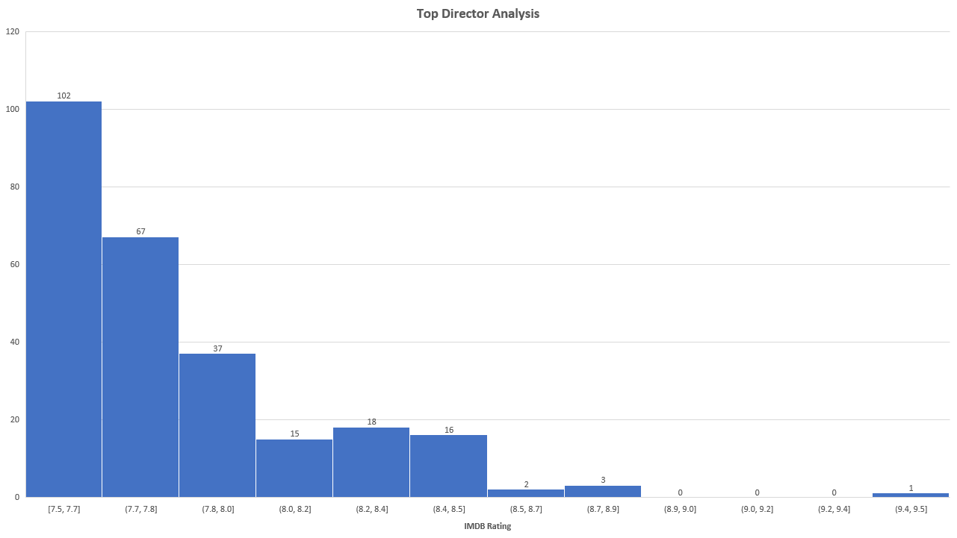

Slide 20
Insights - Budget and Gross Earnings Analysis
We analyzed the correlation between movie budgets and gross earnings to understand the financial performance of movies. Additionally, we identified movies with the highest profit margins.

Slide 21


Insights - Budget and Gross Earnings Analysis
Correlation Analysis: We calculated the correlation coefficient between movie budgets and gross earnings using the Excel CORREL function.
Profit Margin Calculation: The profit margin (Gross Earnings - Budget) was calculated for each movie. We then identified movies with the highest profit margins using the MAX function.

Slide 22
Movie with Highest Profit Margin
Movie Name | Profit Margin
AvatarÂ | 523505847

Slide 23

A correlation coefficient of 0.101033478 suggests a very weak positive correlation between movie budgets and gross earnings.
In other words, there is a slight tendency for movies with higher budgets to have slightly higher gross earnings, but the relationship is not strong.

Slide 24
Project Achievements
Data Analysis Skills: The project enhanced my proficiency in data analysis using Microsoft Excel, particularly in working with large datasets, applying statistical functions, and generating meaningful insights from data. I gained hands-on experience in data cleaning, sorting, and performing various calculations to derive valuable statistics.
Understanding of Movie Factors: By analyzing movie genres, durations, languages, and directors, I deepened my comprehension of the multifaceted factors that influence movie ratings and success. I learned that elements like genre, director, and language play crucial roles in determining audience perceptions and ratings.
Statistical Interpretation: The project provided me with a practical understanding of statistical concepts like mean, median, mode, variance, standard deviation, and correlation. I learned how to interpret these statistics in the context of real-world data analysis and draw meaningful conclusions from them.

Slide 25
Project Achievements
Insights into Film Industry Trends: The analysis of budget and gross earnings in relation to movie profitability shed light on the dynamics of the film industry. I gained insights into the unpredictability of box office success, where a higher budget doesn't always guarantee higher earnings.
Project Documentation: I improved my ability to document and present the findings of a data analysis project, as demonstrated by the creation of summary tables, charts, and the preparation of insights for a presentation.
Real-World Application: This project simulated a real-world scenario where data analysis is employed to make informed decisions. It showcased how data-driven insights can be utilized in the film industry to identify patterns and trends, ultimately aiding in decision-making and strategy development.

Slide 26


Conclusion
In summary, the IMDB Movie Analysis project was a valuable learning experience that deepened my data analysis skills and provided me with practical insights into the impact of various factors on movie ratings and profitability.
It reinforced the importance of data-driven decision-making in various domains, including the entertainment industry.

Slide 27

LINKS
RAW DATASET - CLICK HERE !!!
IMDB MOVIE ANALYSIS - CLICK HERE!!!
(Please Download & Open)

Slide 28
THANK YOU!!

